Slide 1
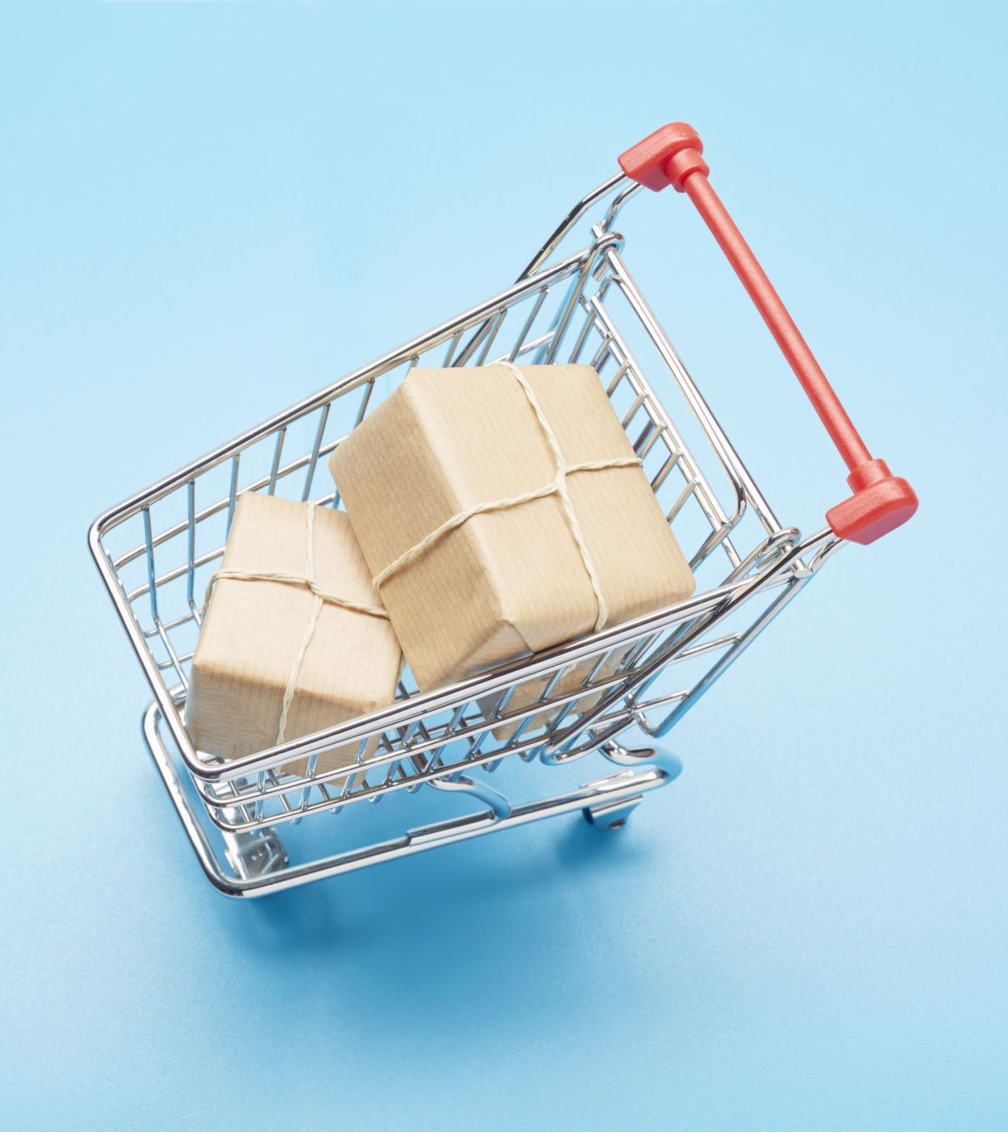
RAINBOW GROCERY STORE

Slide 2

Team 3: Shaheen Nazar Madhavi Ranganadha Pallavi Saboo Ankitha Shetty

Slide 3
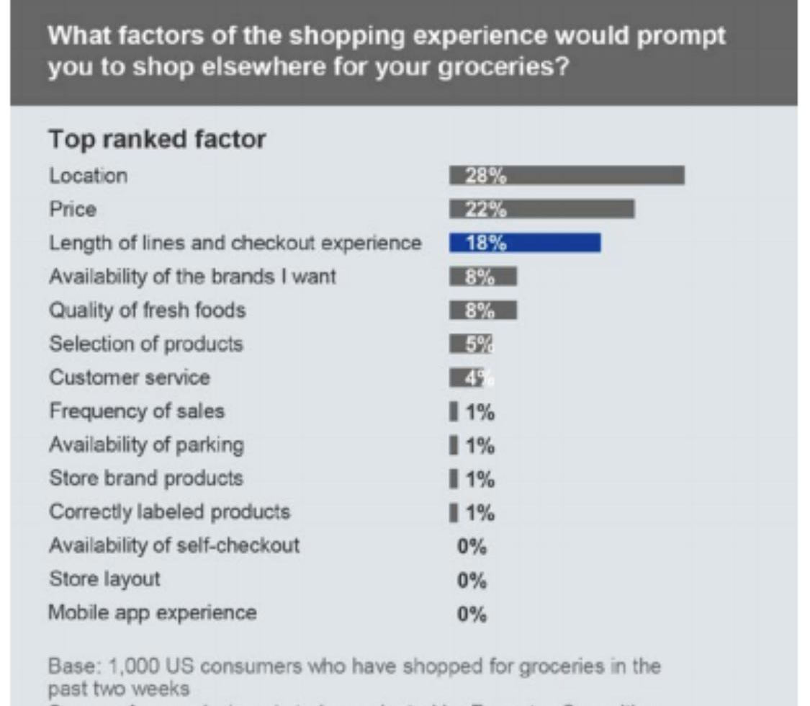
Background

Slide 4
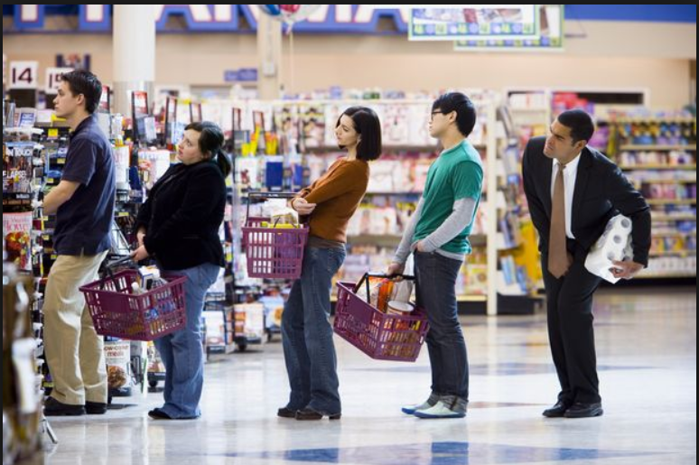
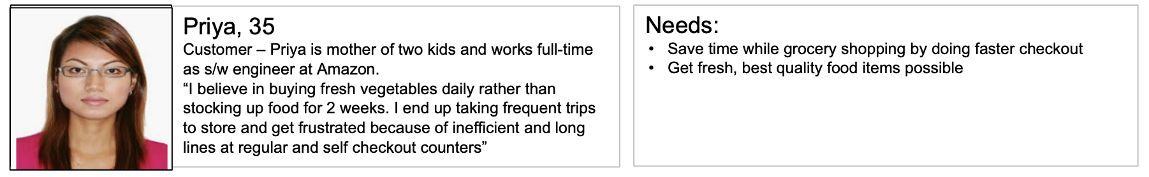
Problem Statement
Long wait in queues at supermarkets that lead to lost sales and poor customer experience
High operating costs for payment transactions
Current Automated checkout systems are cumbersome

Slide 5

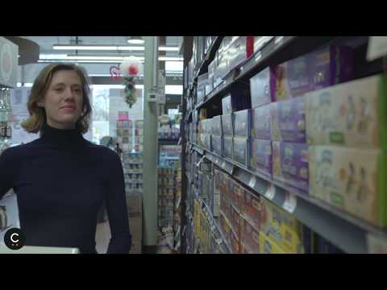
Solution

Slide 6
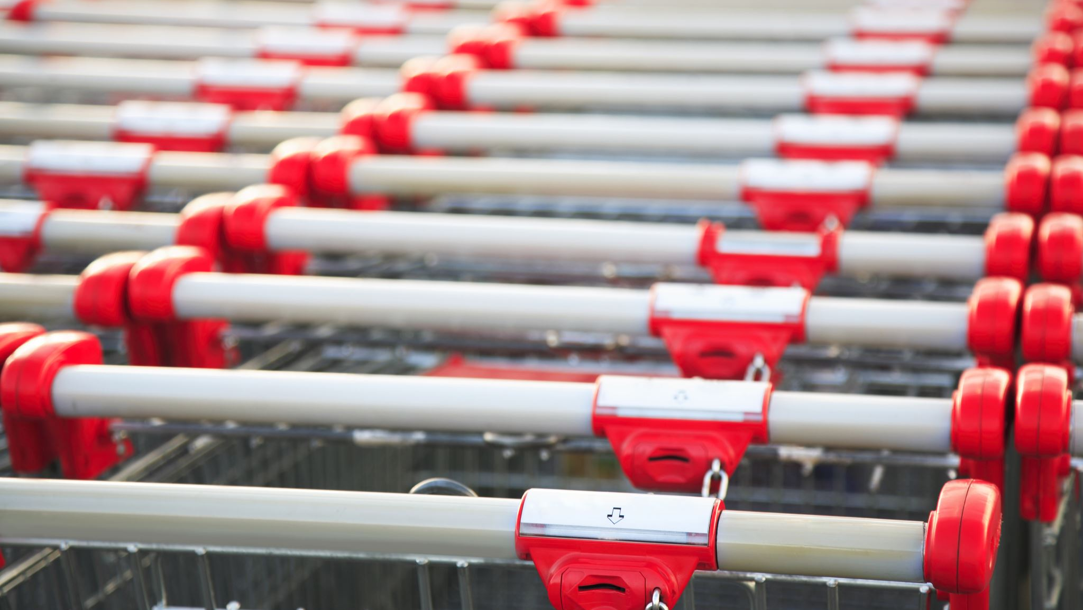
Product Name: Smart Cart
Company Size: Medium (100-200 employees)
Target Company: Small chain grocery stores around 30,000 square feet.
Value Proposition: Improve customer experience by allowing customers to pay directly and skip checkout lines.
MVP :
Provide a Smart Cart with scanner that requires the customer to scan a barcode found on the items.
Once a shopper has all the items they need, they can pay via a card machine or Apple/Samsung pay on the cart and leave the store without having to queue
Product
Summary

Slide 7
Product Definition
Function
Smartcart is an interactive touchscreen display affixed to the handlebars of a
shopping cart which will allow users to perform the following actions:
Scan items to a checkout list
Search for items
Search for the aisle locations of items
Obtain coupons for items
Create Wishlist
Search for deals

Slide 8
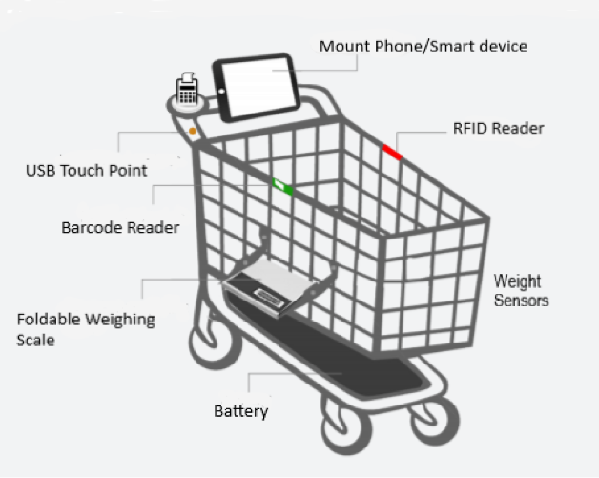
Proposed System
Customer is authenticated using user login.
RFID/Barcode scanner to identify and track tags attached to items
On product scan, items price, and description would be displayed.
Foldable weighing scale can be used to weigh food items
Weight sensors & Alarm system : discrepancy between weight of cart and weight of scanned items, the alarm system would trigger.
Once payments are confirmed, digital invoice are generated and sent to customer’s email.

Slide 9
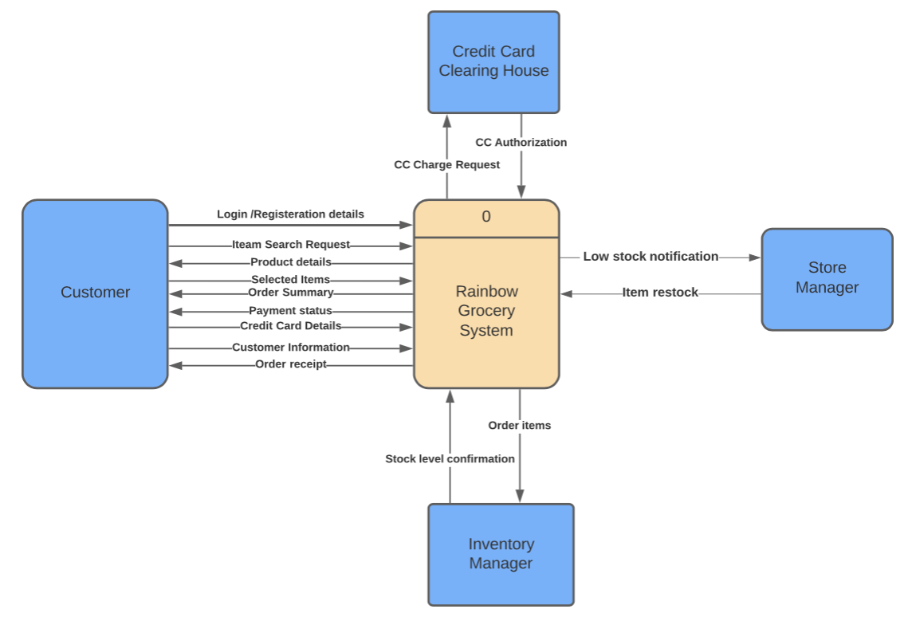
Context
Diagram

Slide 10
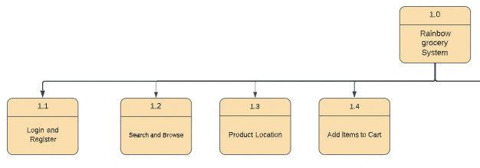
Structure Diagram

Slide 11
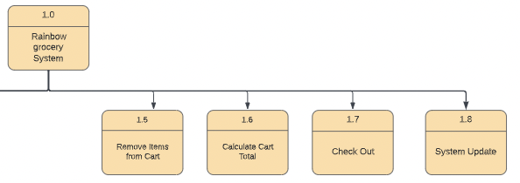
Structure Diagram

Slide 12




Payments
Partnering with trusted payment platforms.
Secure all transactions using SSL protocol.
Choosing payment gateway with tokenization.
Each item will have an RFID tag and each cart will have an RFID reader.When the cart reaches a certain distance to the in-store component and if there is any discrepancy between the weight of the cart and the weight of the scanned items, the alarm system would trigger.
Security & Regulations
Anti Theft
Regulations
Our product supports customer data privacy and payment data PCI, FCC security standard

Slide 13
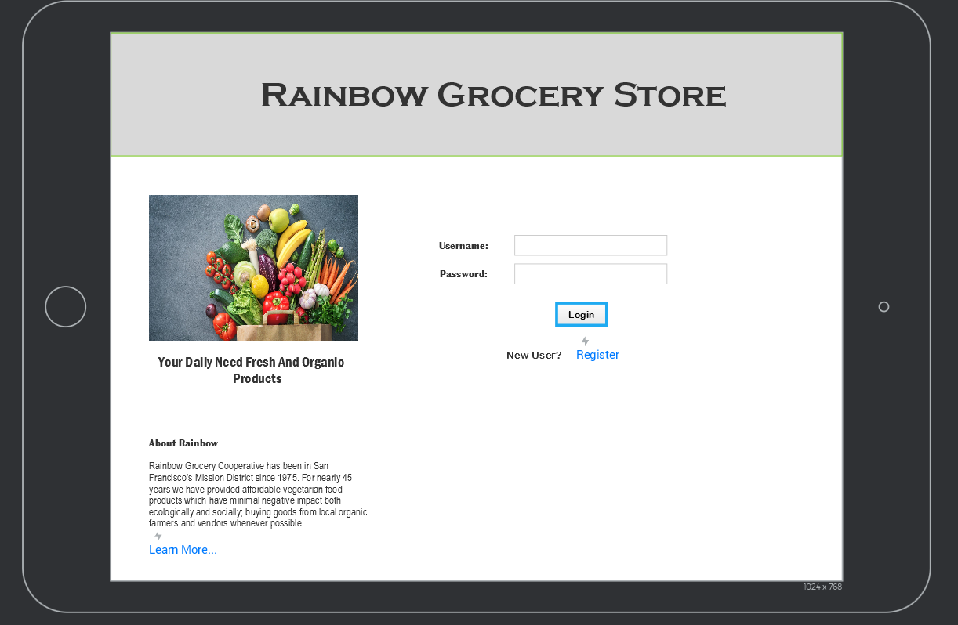
Customer Sign In

Slide 14
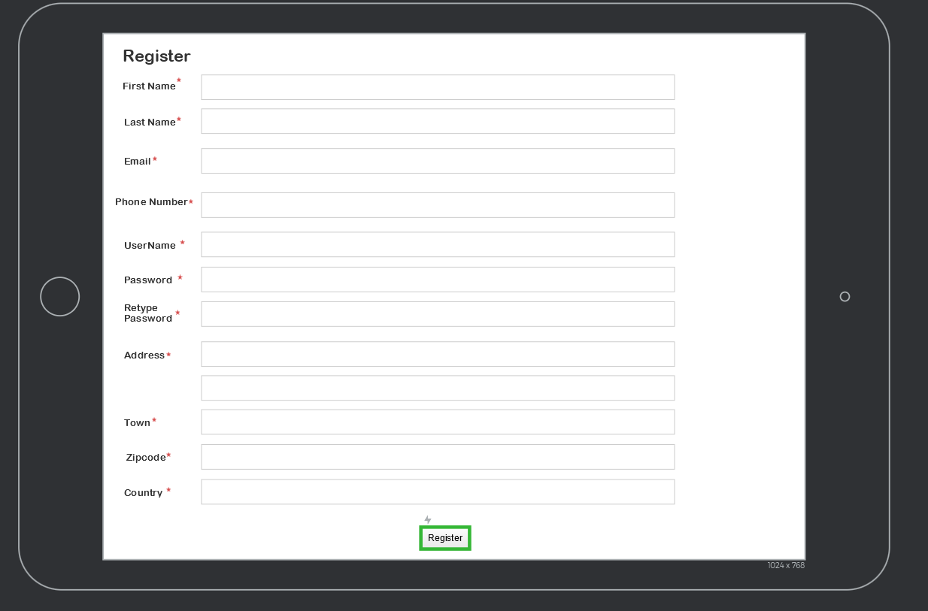
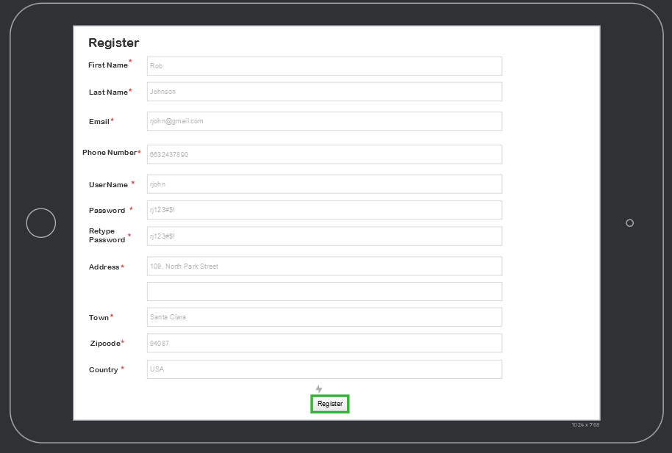
Customer Sign Up

Slide 15
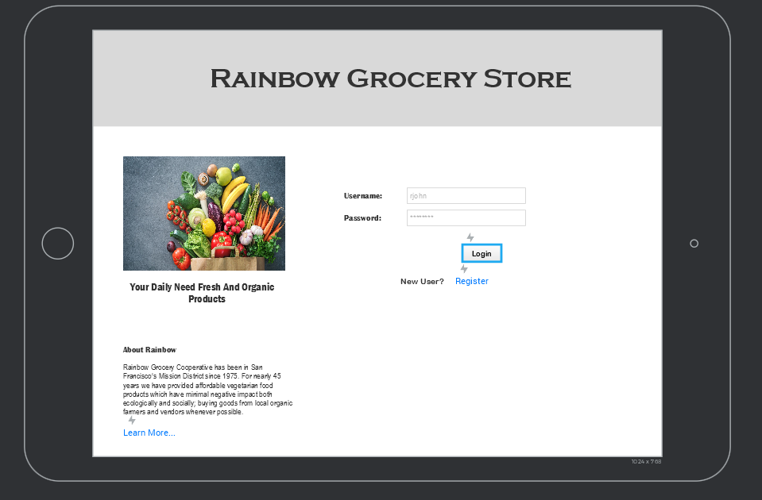
Log In

Slide 16
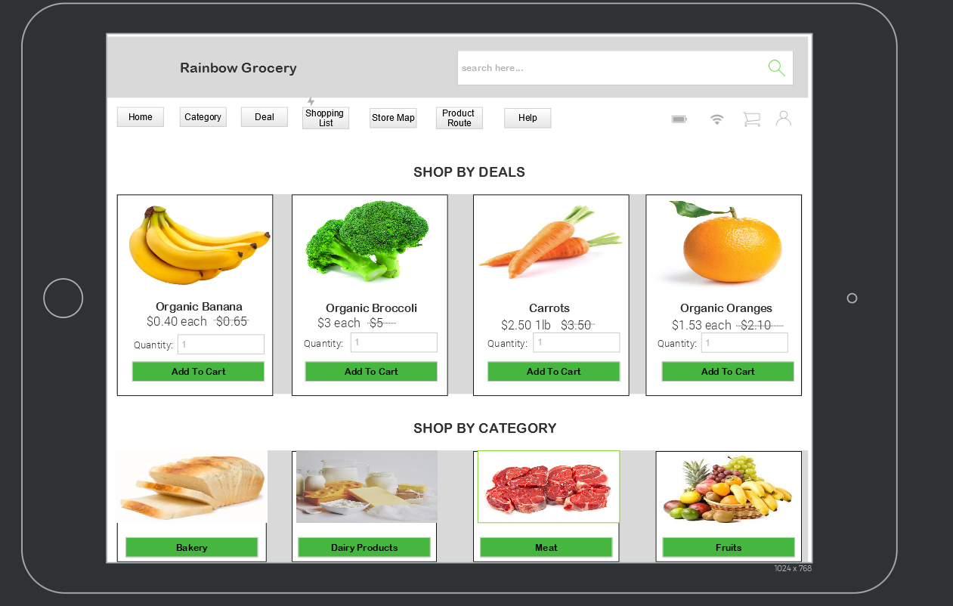
Product Homepage

Slide 17
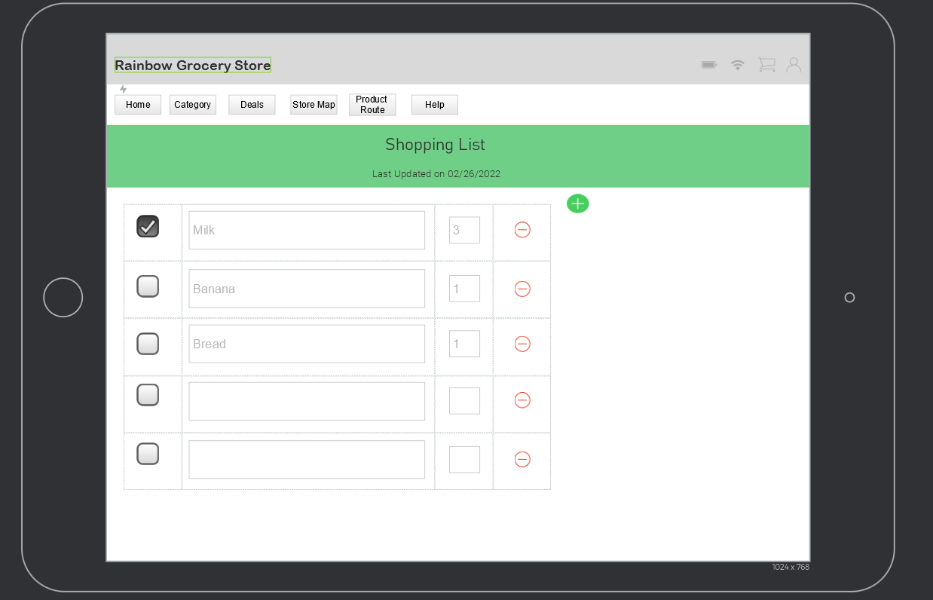
Wishlist

Slide 18
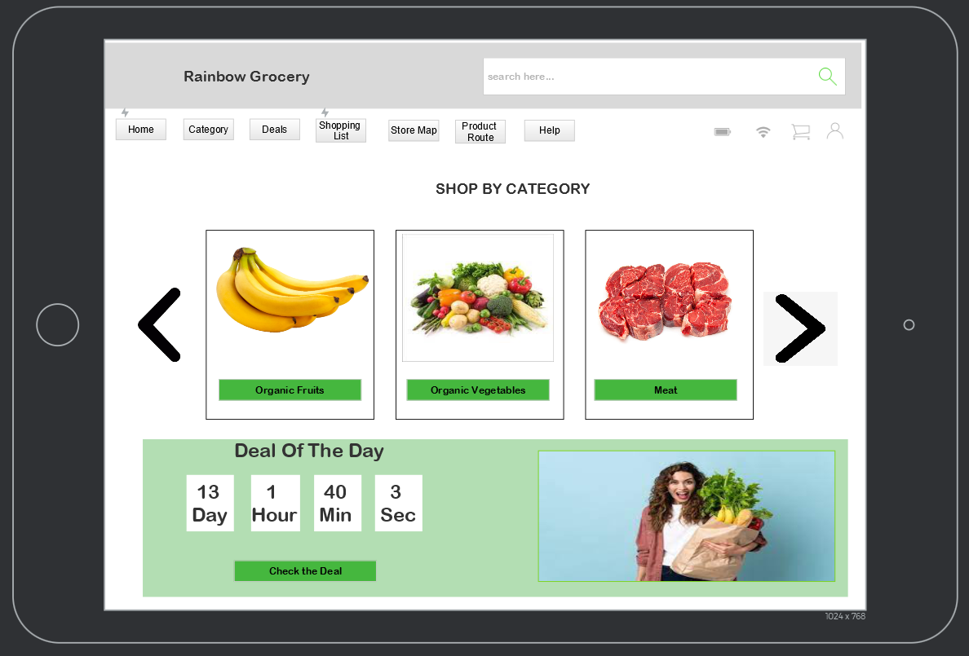
Shop By Category

Slide 19
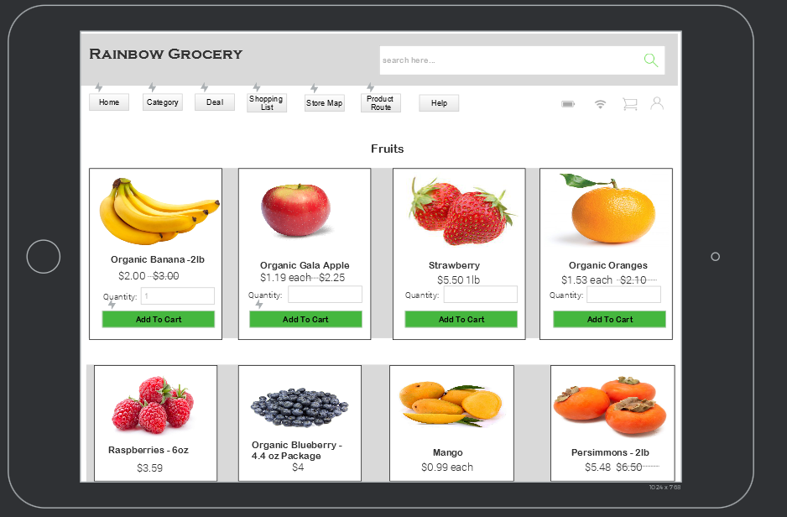
Category

Slide 20
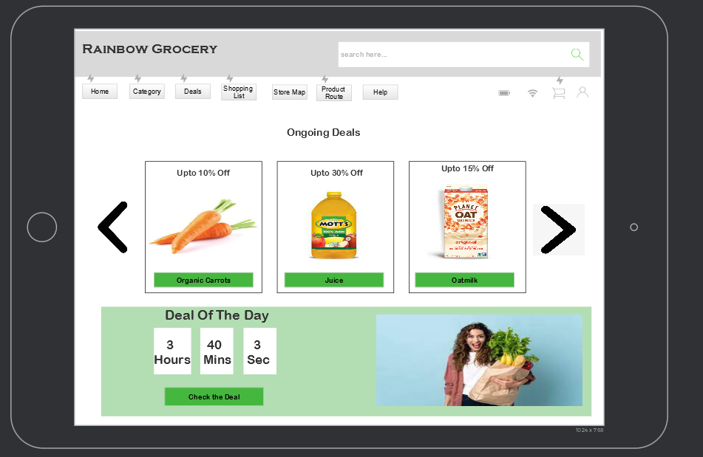
Deals

Slide 21
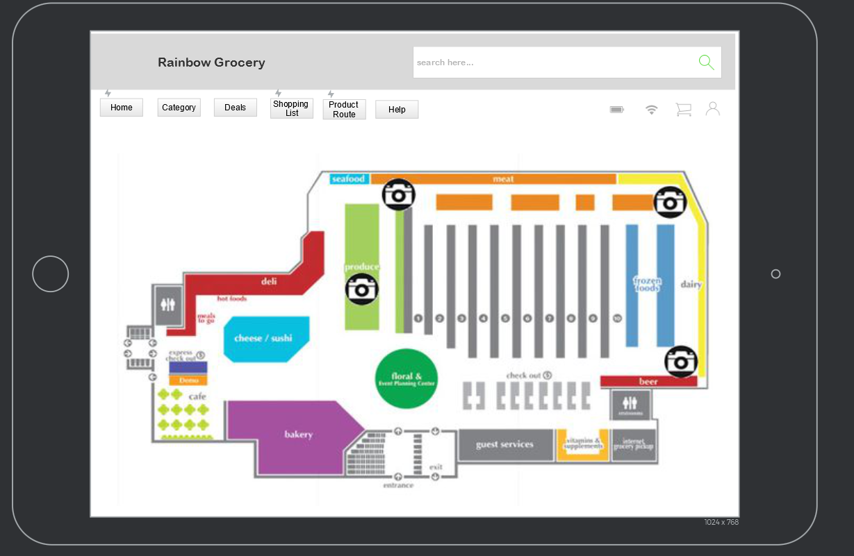
Locate a Product

Slide 22
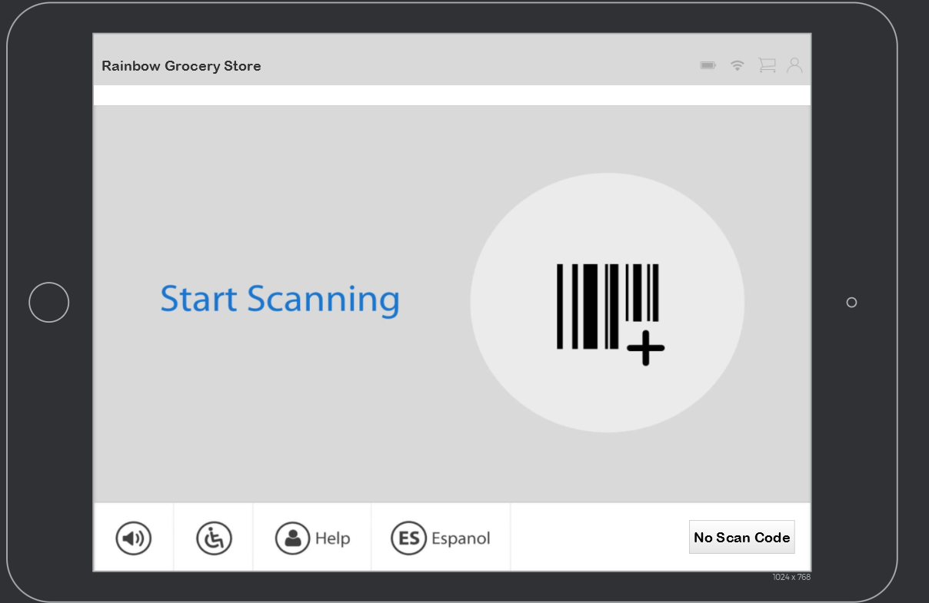
Scan a product

Slide 23
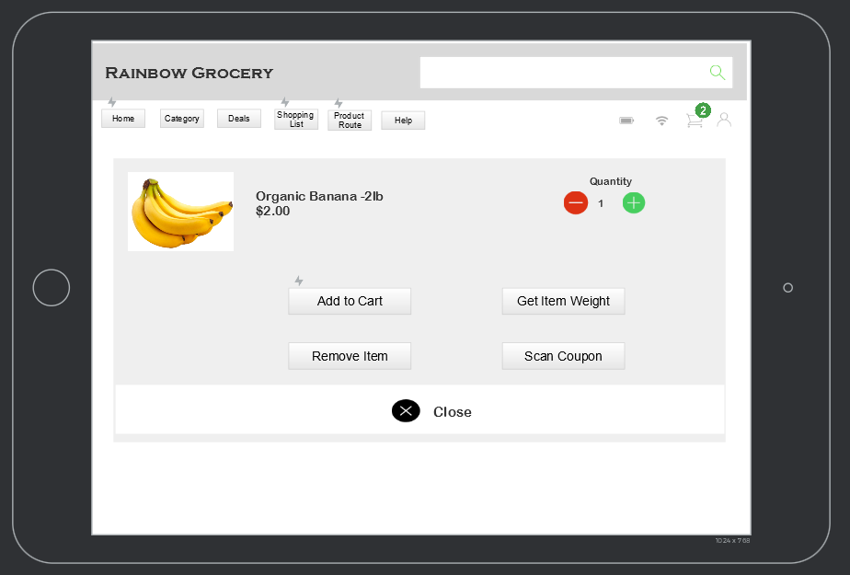
Add Item to Cart

Slide 24
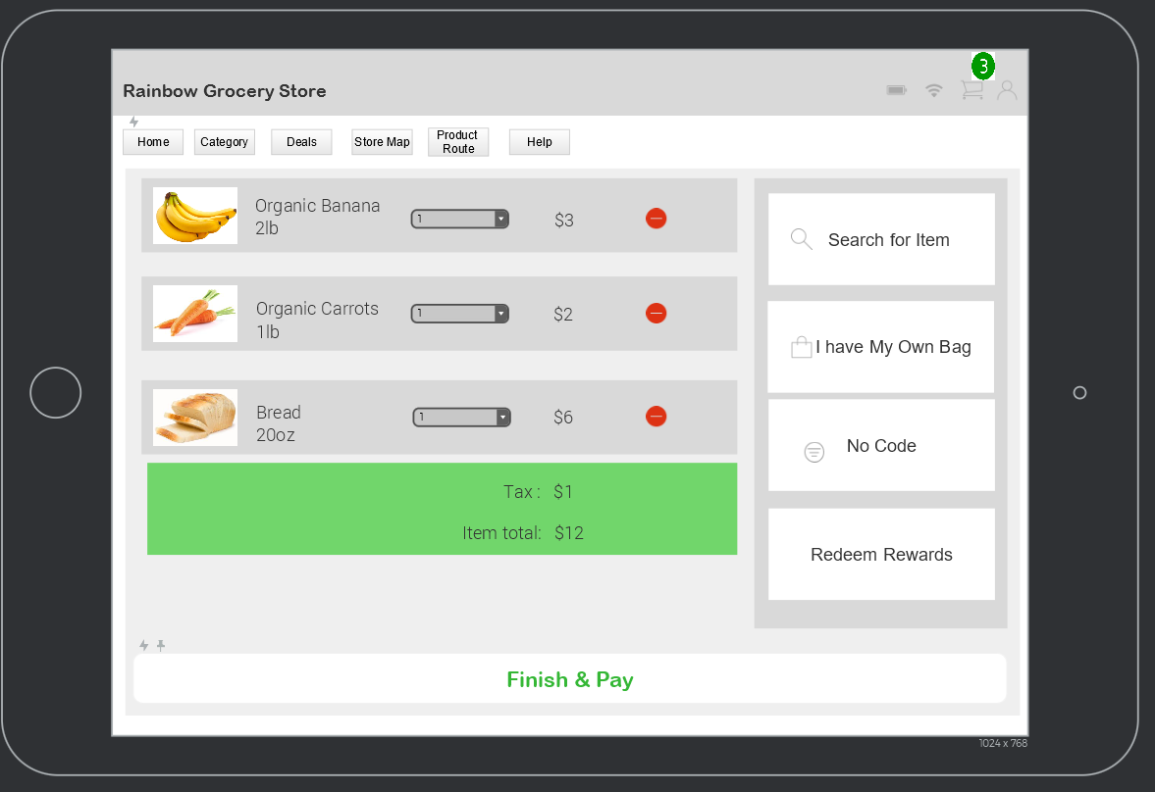
Cart Total

Slide 25
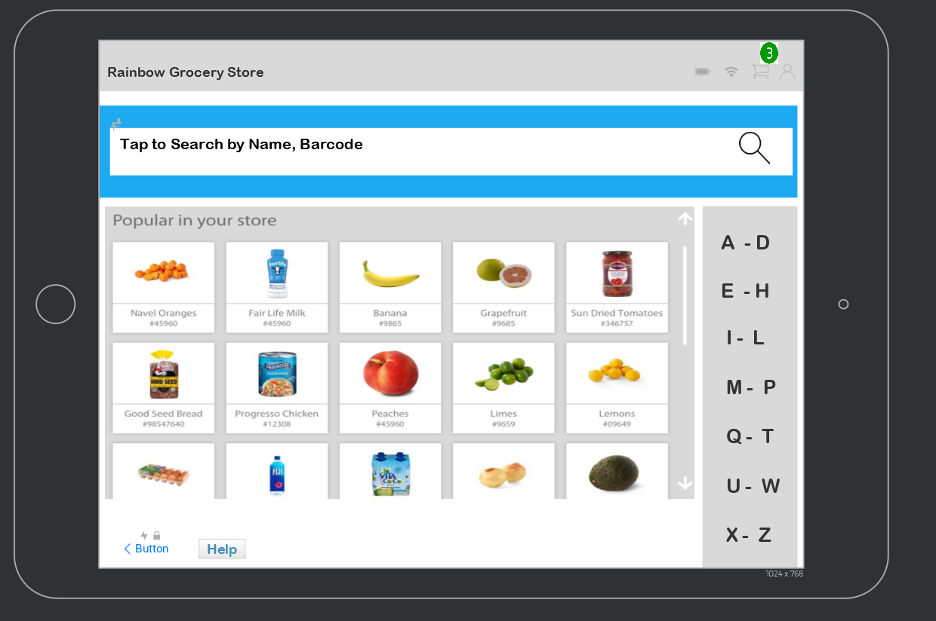
Search Product

Slide 26
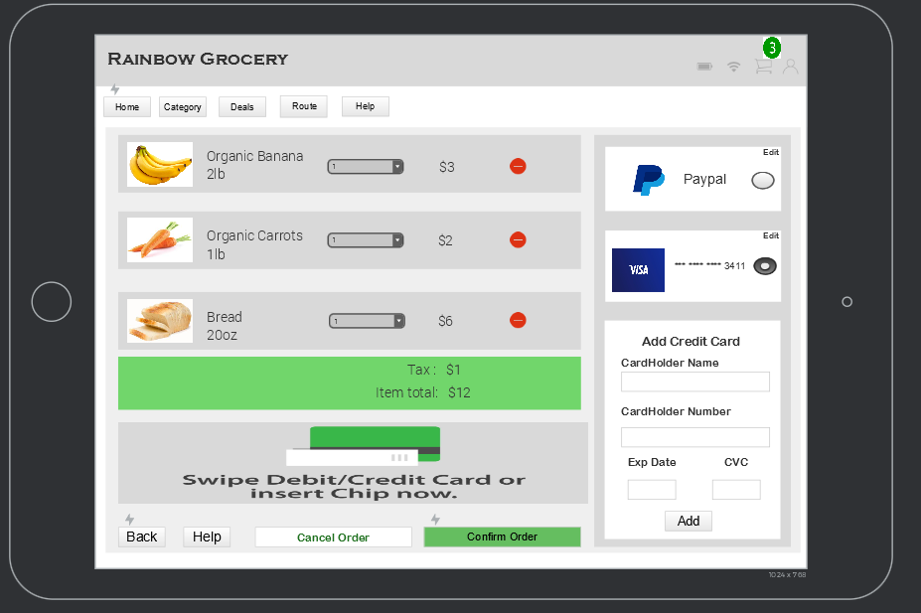
Confirm Order

Slide 27
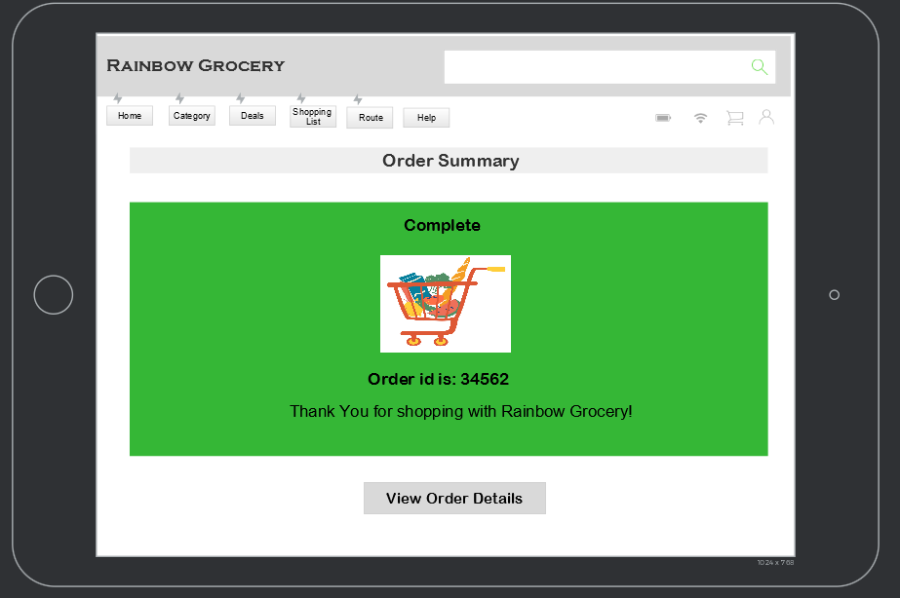
Order Summary

Slide 28
Incorporate deep learning algorithm to identify items with the help of image recognition cameras
Monetize on Products ads and promotions on app
Future Scope
Monetize on aggregated data for marketing purposes
Online ordering
Incorporate machine learning algorithm to provide personalized product recommendation
Recommend recipes based on items in cart

